Slide 3
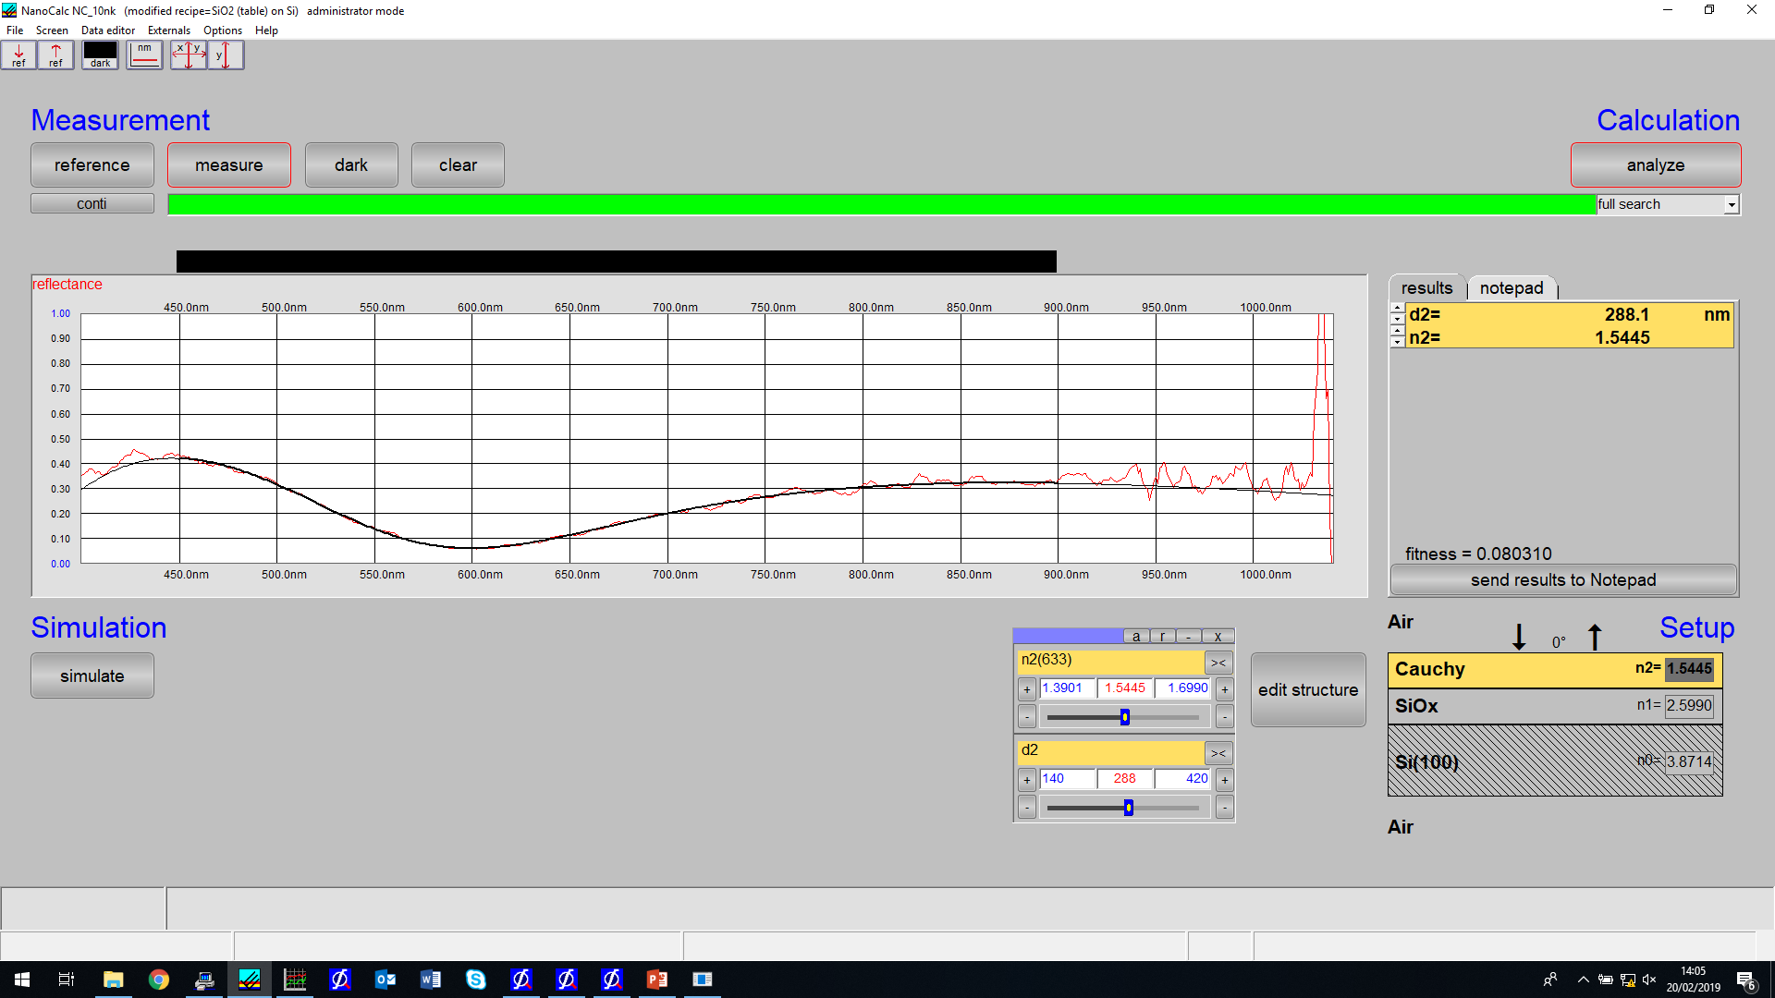
Run:2 PS id:350 ref:topsiloptics static measurement - redo limits
(inside)

Slide 4
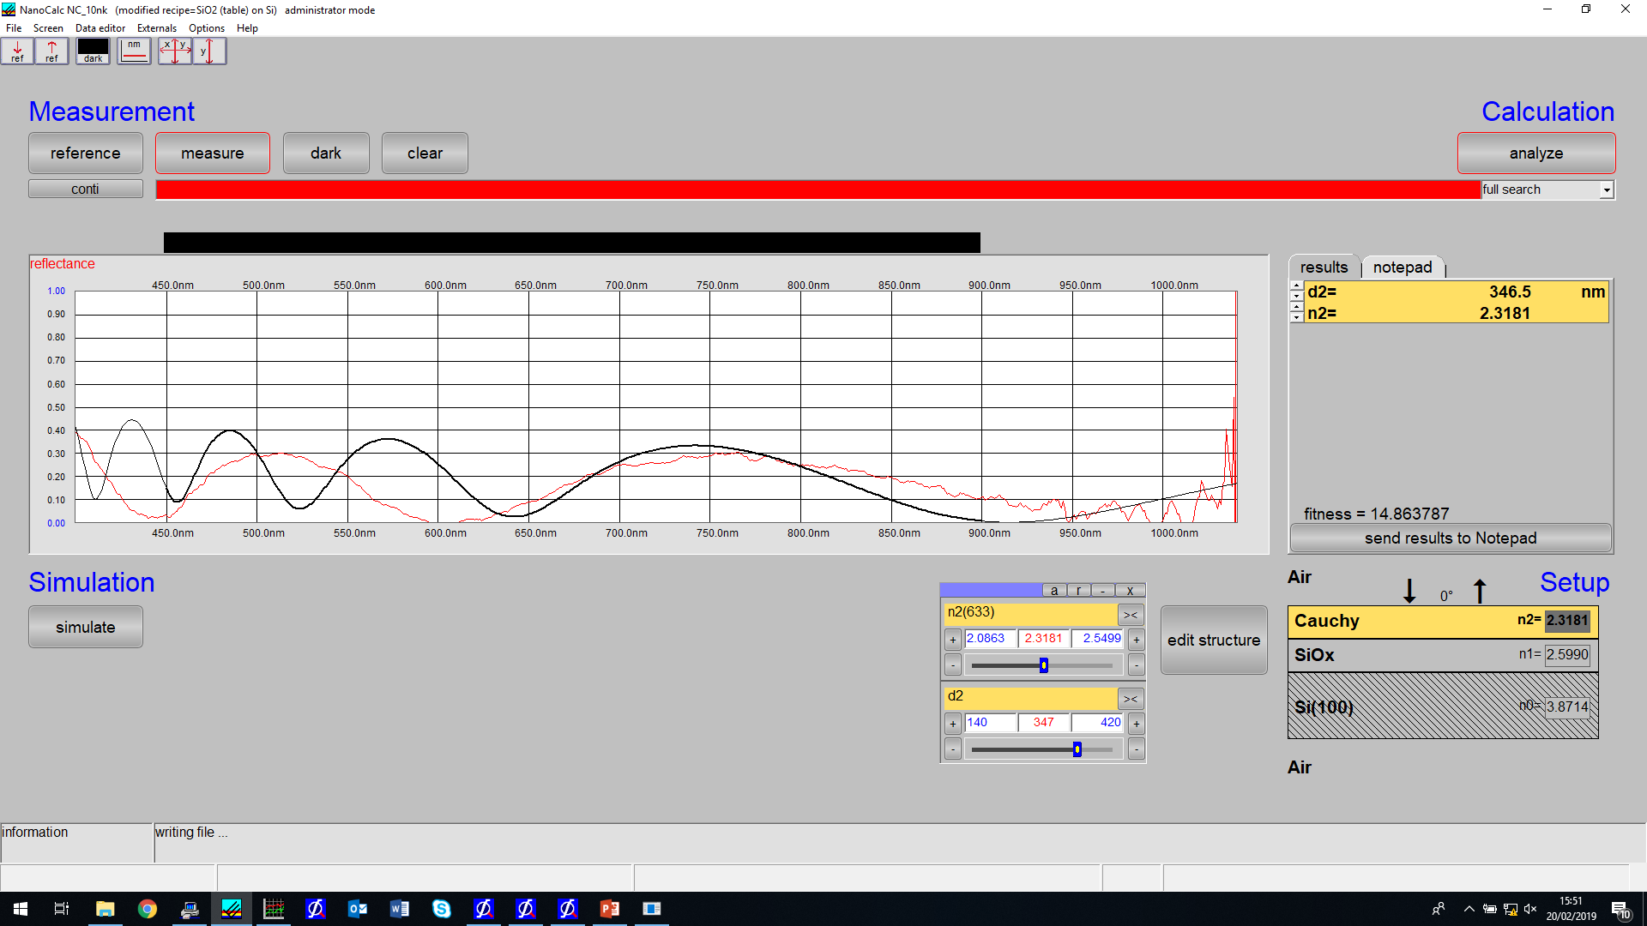
Kl.15:50 – weird because of crappy model limits – refract too big, thickness too small

Slide 5
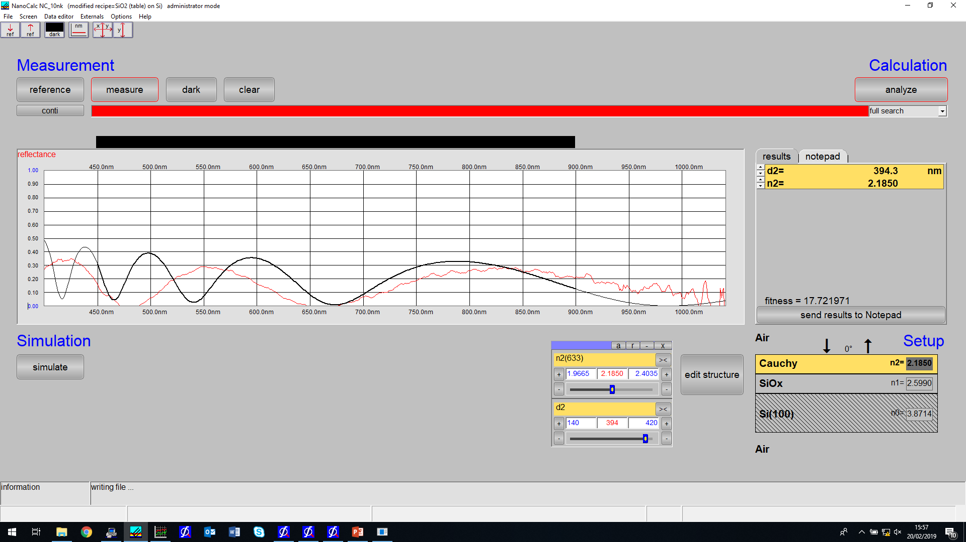
Kl.15:58

Slide 6
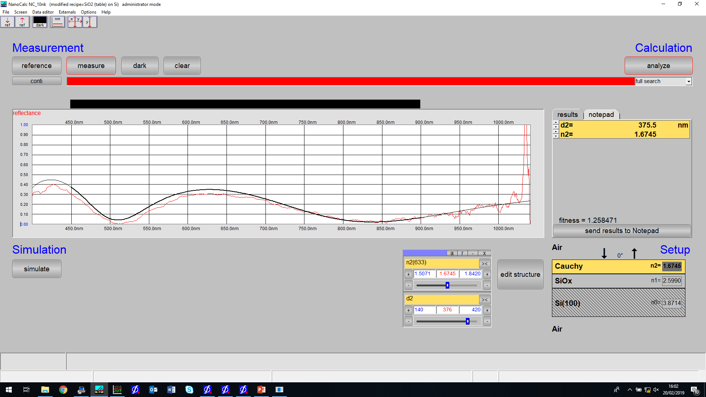
Kl.16.02
1.6745,375.5 nm

Slide 7

Kl.16:11
1.5720,336.8 nm

Slide 8
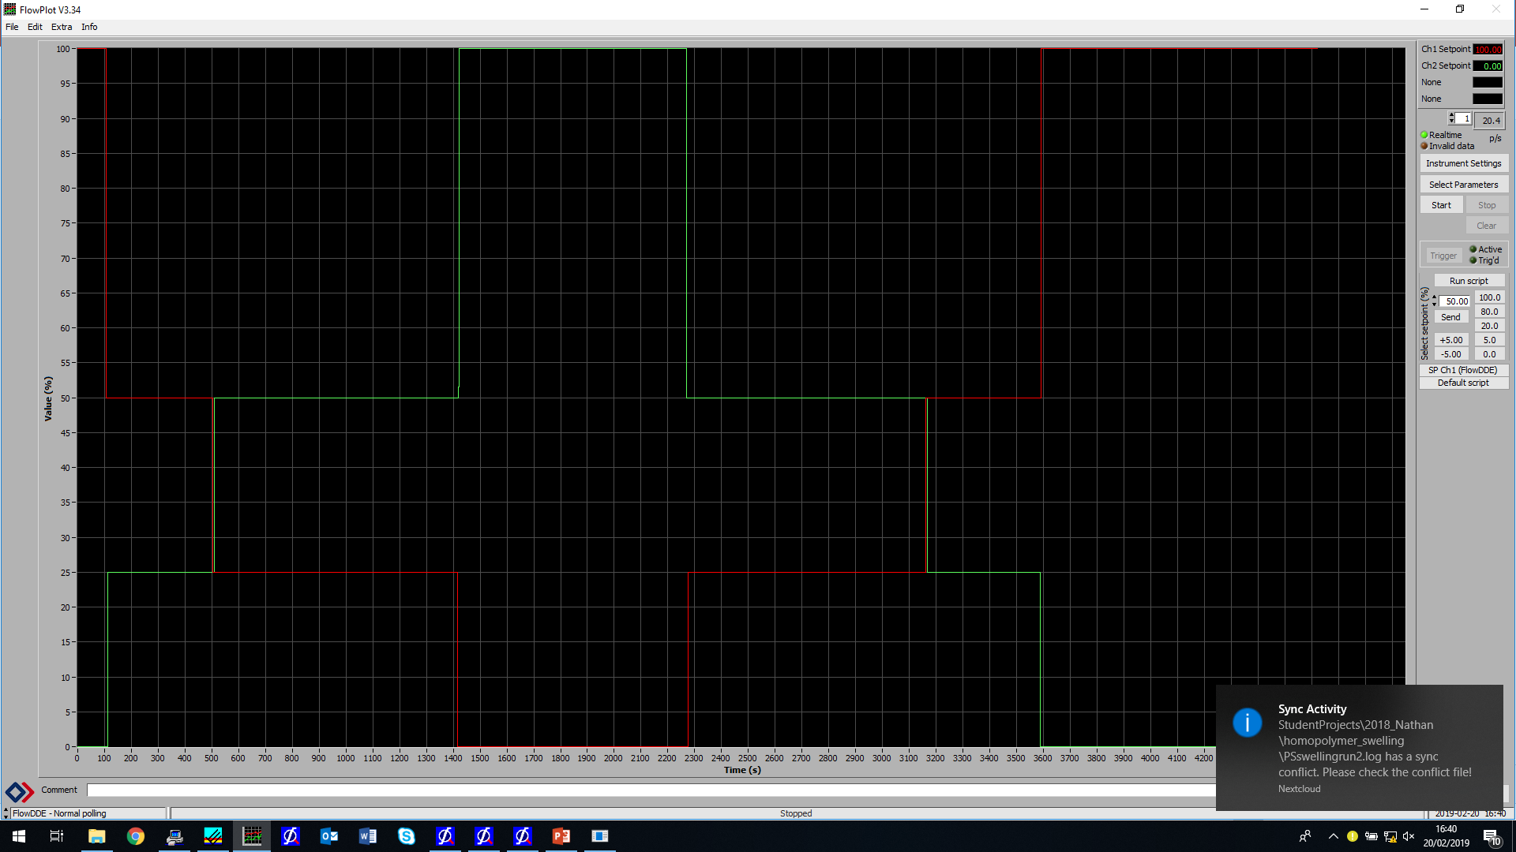

Slide 9
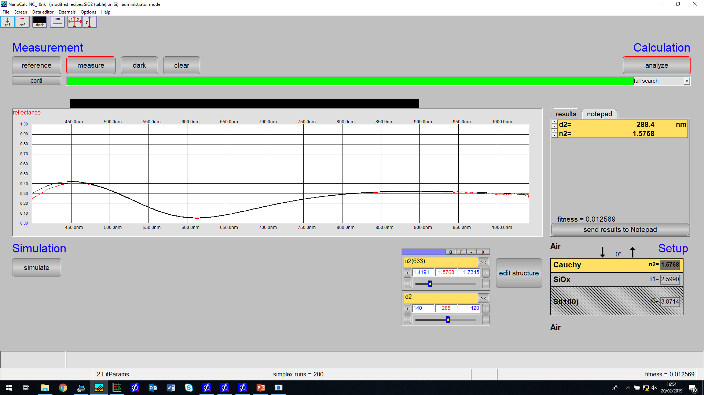
After swelling. Filename:afterswelling.xy

Slide 10
